Slide 1
Sensory Systems

Slide 2
Sensory neurons transmit information to the CNS; and Sensation is based on neural input to the brain; but sensory systems often have accessory structures associated with the sensory neurons

Slide 3
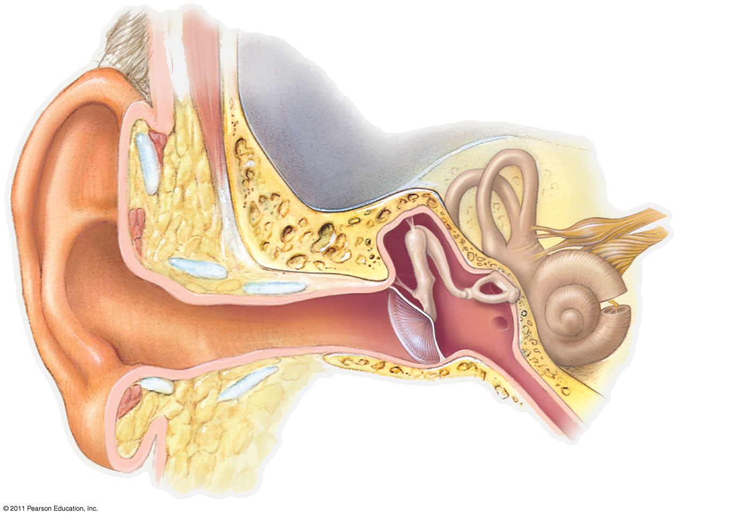
Figure 50.10a
Outer ear
Middle ear
Inner ear
Skull
bone
Stapes
Semicircular
canals
Incus
Malleus
Auditory nerve
to brain
Cochlea
Oval
window
Eustachian
tube
Auditory
canal
Pinna
Tympanic
membrane
Round
window
Notes:
Figure 50.10 Exploring: The Structure of the Human Ear

Slide 4
Sensory neurons act as transducers
Transducer: convert one form of energy (e.g. mechanical) into another (cell membrane voltage)

Slide 5
Sensors can be classified according to the “adequate stimulus”
Photoreceptors (light)
Chemoreceptors (chemicals)
Mechanoreceptors
Thermoreceptors (temperature)

Slide 6
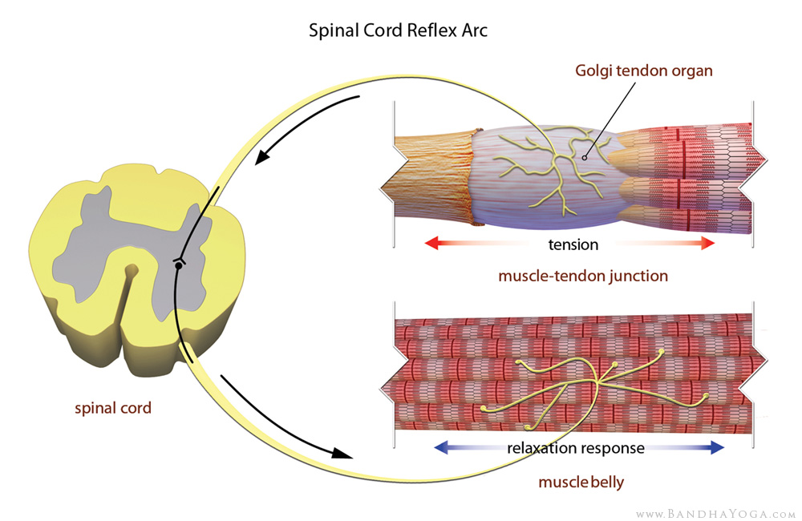
There are many varieties of mechano-sensors

Slide 7
In the ear
The organ of Corti (in the cochlea)
  they have hair cells that are lined in rows
  When the tectorial membrane gets hit, the hairs are stimulated, and it causes a change in membrane voltage

Slide 8
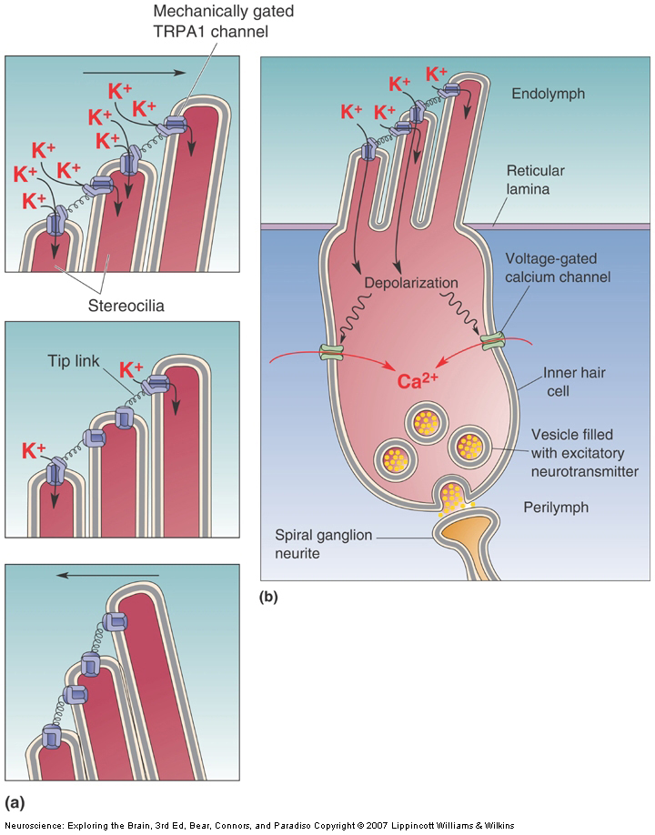
Sensory receptors act as transducers
Change in the mechanical position of the hair cells leads to changing open/close status of ion channels (and change in V_{m})
Notes:
The bending of the hairs cause changes in the potassium channels
In these cells, K+ is outside and causes depolarization (opposite to every other cell in the body)

Slide 9
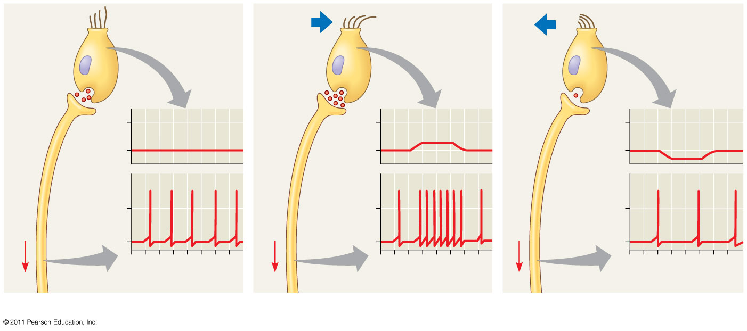
Figure 50.11
The change in membrane voltage leads to a change in neurotransmitter release
“Hairs” of
hair cell
Neurotrans-
mitter at
synapse
More
neuro-
trans-
mitter
Less
neuro-
trans-
mitter
Sensory
neuron
−50
−50
Receptor potential
−50
−70
−70
−70
Membrane
potential (mV)
Membrane
potential (mV)
Membrane
potential (mV)
Action potentials
Signal
0
Signal
0
Signal
0
−70
−70
−70
0
1
2
3
4
5
6
7
0
1
2
3
4
5
6
7
0
1
2
3
4
5
6
7
Time (sec)
Time (sec)
Time (sec)
(a) No bending of hairs
(b) Bending of hairs in one direction
(c) Bending of hairs in other direction
Notes:
Figure 50.11 Sensory reception by hair cells.
Neurotransmitter being released is based on the membrane voltage, there is not limit that needs to be hit before something is released (?)

Slide 10
Figure 50.11
Neurotransmitter induces action potentials in the next cell in line
“Hairs” of
hair cell
Neurotrans-
mitter at
synapse
More
neuro-
trans-
mitter
Less
neuro-
trans-
mitter
Sensory
neuron
−50
−50
Receptor potential
−50
−70
−70
−70
Membrane
potential (mV)
Membrane
potential (mV)
Membrane
potential (mV)
Action potentials
Signal
0
Signal
0
Signal
0
−70
−70
−70
0
1
2
3
4
5
6
7
0
1
2
3
4
5
6
7
0
1
2
3
4
5
6
7
Time (sec)
Time (sec)
Time (sec)
(a) No bending of hairs
(b) Bending of hairs in one direction
(c) Bending of hairs in other direction
Notes:
Figure 50.11 Sensory reception by hair cells.

Slide 11
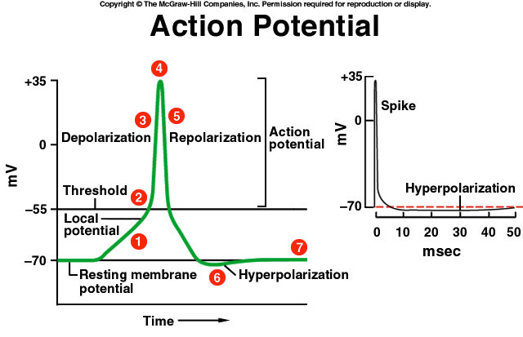
Action potentials are stereotypical; there is nothing “auditory” about action potentials in the auditory nerve

Slide 12
Multiple components of the sensory stimulus may be encoded by separate mechanisms
We can distinguish frequency, loudness, tone, and direction of auditory stimulation, for example

Slide 13
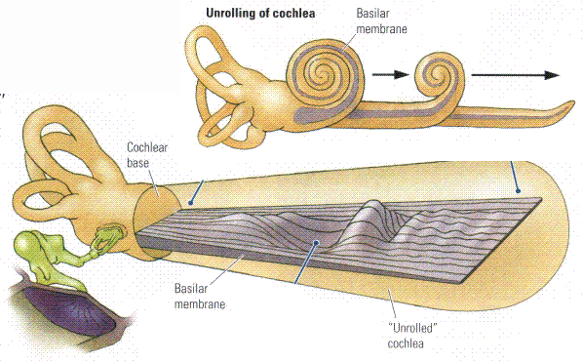
Sound frequency is encoded primarily by the location of maximal vibration of the basilar membrane (the “place principle”)
Notes:
It changes in thickness and width, this allows for the detection of different frequencies and intensity

Slide 14
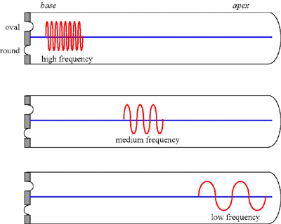
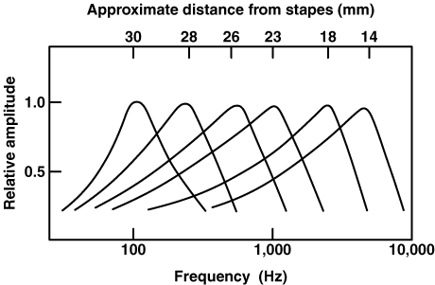
High frequency more strongly vibrates the basilar membrane near the oval window (connection with the middle ear)

Slide 15
Sounds can create complex patterns of stimulation
The basilar membrane wont just have a single wave, there will frequently be complex waves

Slide 16
Sound location is determined by differences in the timing and intensity of the signals coming from the two ears
There needs to be a difference (timing, intensity, etc.) in what you hear from one ear and another to tell where the sound is coming from

Slide 17
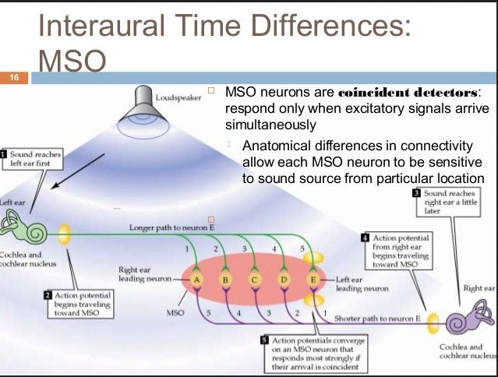
The olivary nuclei can detect differences in the time of arrival from the two ears
Notes:
how the ear tells time differences (for directionality)

Slide 18
Sensory receptors act as filters
Sensation depends on receptor mechanisms

Slide 19
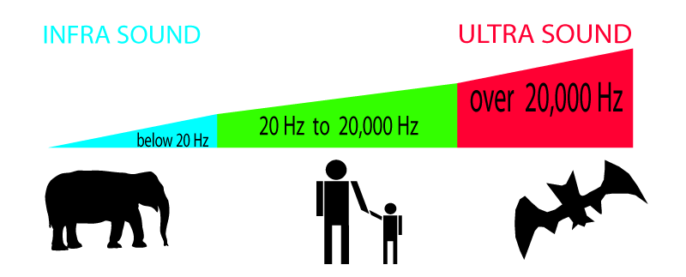
Some animals can sense ranges of sound that we cannot
Notes:
Infrasound: lower than human hearing
Ultrasound: higher than human hearing

Slide 20
Senses are not necessarily accurate representations of the world
If a stimulus persists, the sensory response tends to diminish
Notes:
The body adapts to ignore some senses (see next slide’s graph)

Slide 21
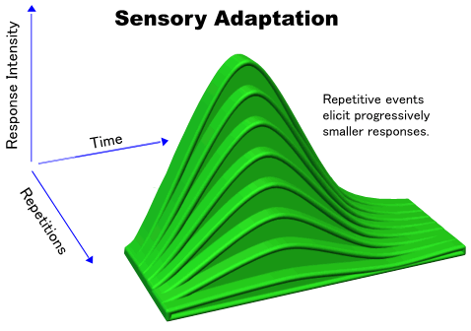
Notes:
More repetitions of the same stimulus lowers response intensity
Senses more responsive to changes in stimuli

Slide 22
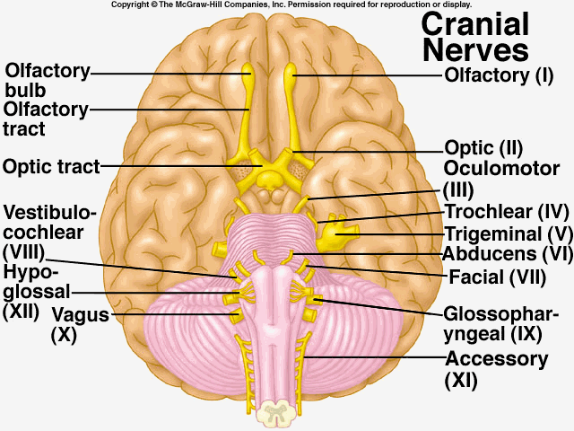
Senses in the head transmit their signals via cranial nerves
Hearing is transmitted via cranial nerve VIII, the Cochlear (Auditory) Branch of the Vestibulo-cochlear Nerve

Slide 23
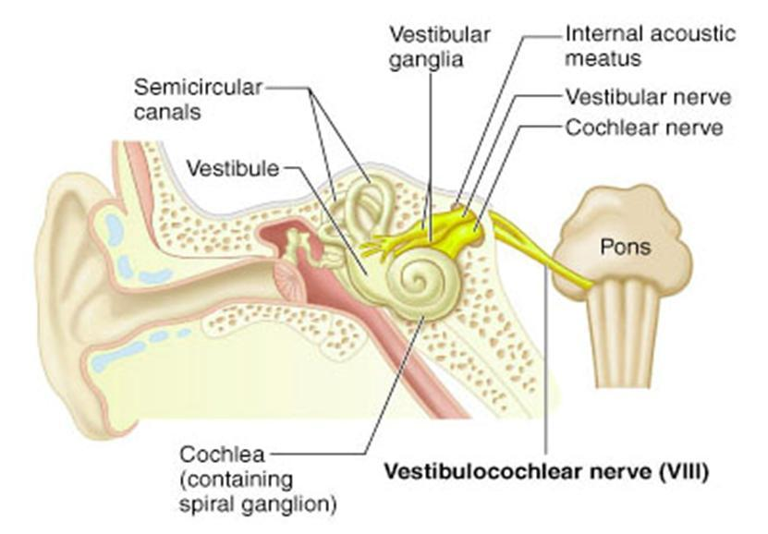

Slide 24
As the signal passes through brain regions, a map of the cochlea is maintained
Other body systems also maintain maps in the brain, like for muscle coordination or general sensation

Slide 25
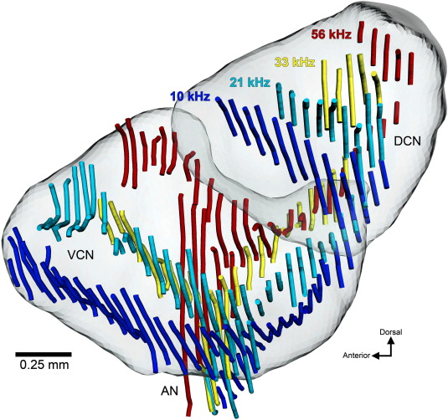
Cochleo-topic mapping
Dorsal cochlear nucleus
http://www.youtube.com/watch?v=N90j2h3M0ic&list=UU9Z64ZO5WLO261CpzUmvAYw
Notes:
Changes in sound cause different areas in the brain to react

Slide 26
Conscious perception of a sensory stimulus requires encoding in the cerebral cortex
Sound is perceived when stimulation reaches regions of the temporal lobe

Slide 27
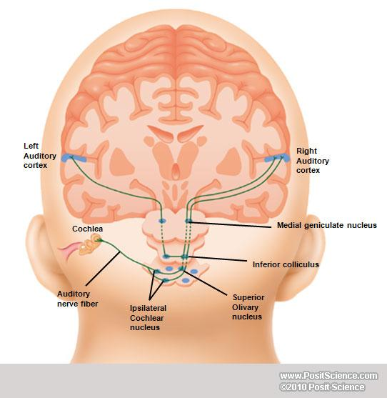
thalamus
Notes:
Nucleus (blue spots) = synapses (like the olivary nucleus and ipsilateral cochlear nucleus)
Auditory cortex is where conscious processing of sound is done
Geniculus (geniculate) means knee shaped

Slide 28
Pathways to the cortex are multi-synaptic (i.e., there are several neurons in sequence)
Each region of synapses (brain nucleus) serves as a site of integration
Between nuclei, crossing over (decussation) of axons leads to bilateral representation

Slide 29
Senses are “projected”
Vision seems like it comes from the front of our heads—when in fact it comes from the back!
Notes:
The brain makes it seem like images/sounds come from whatever direction even though they are processed in the brain

Slide 30
Sensory integration centers are connected to many other brain regions
Vision is a critical component of balance and language, for example

Slide 31
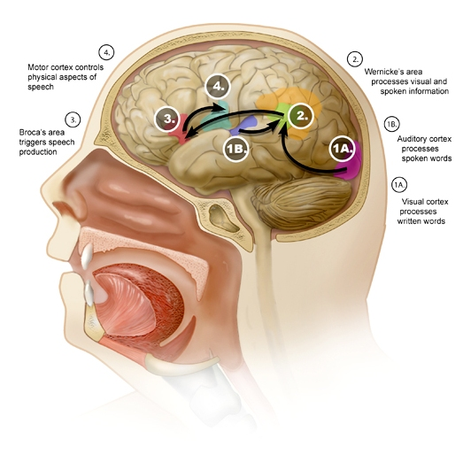
Brain areas involved in language
Notes:
Different parts have to work together to do different things (in this case, processing language)

Slide 32
The processing of auditory signals imposes higher levels of interpretation

Slide 33
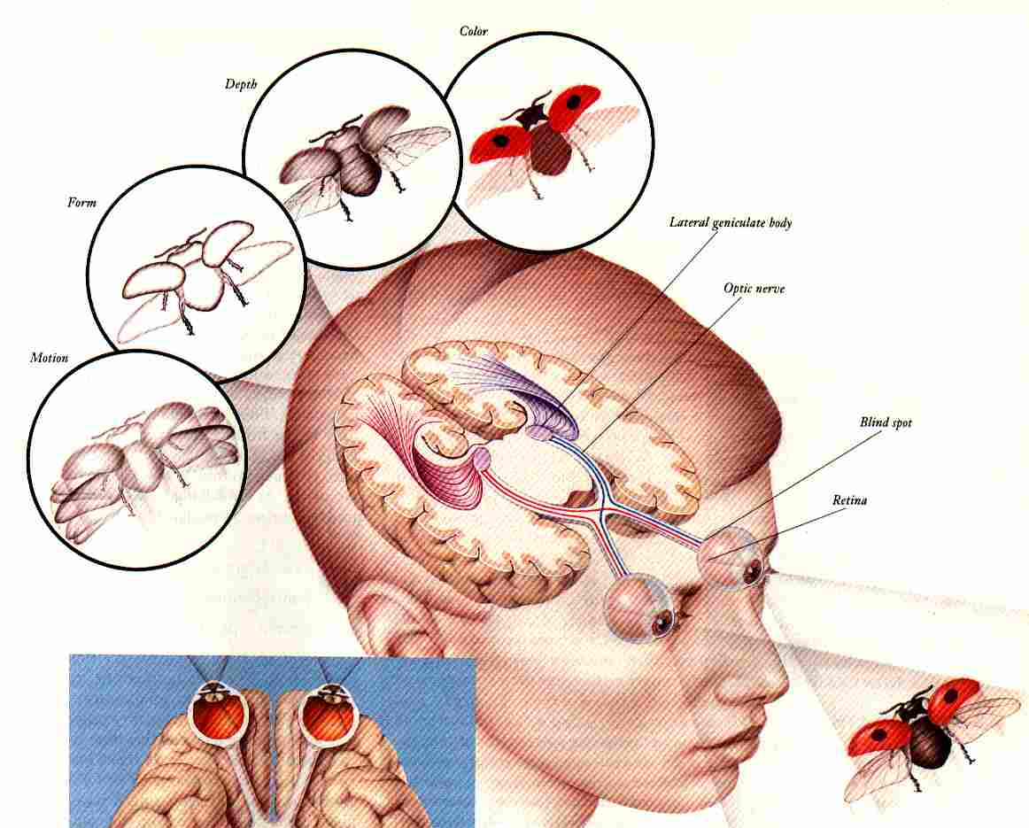
In vision, different regions of the brain are activated by different elements of a scene (shape, color, edges, movement, etc)
The brain may divide senses into components

Slide 34
In language, different parts of speech are encoded in different brain regions

Slide 35
Useful videos
https://www.youtube.com/watch?v=Ie2j7GpC4JU until around 7 minutes

